Slide 1
2011 Economic Forecast February 8, 2011 University Plaza Hotel Springfield, Missouri Dr. David Mitchell, Director Bureau of Economic Research

Slide 2
Change in Real GDP Qtr. To Qtr.

Slide 3
GDP Components

Slide 4
US Employment

Slide 5
US Employment

Slide 6
US Unemployment Rate

Slide 7
US Unemployment Rate with Discouraged Workers

Slide 9
US Employment (2000s Average Growth Rate in Employment)
12.6 Million Jobs

Slide 10
US Employment (1990s Average Growth Rate in Employment)
7.8 million jobs

Slide 11
US and Missouri Median Home Prices Constant Dollars 2010:Q2
Peak 2006:Q4
Peak 2006:Q4

Slide 12
Housing Prices in Missouri Cities 1995 Q1 = 100

Slide 13
US and Missouri Home Prices (1980:Q1 = 100 ; Constant $1980)
122.6
103.3

Slide 14
Real Residential Value of Construction (Millions of 2010 $ SAAR)

Slide 15
New Single Family Home Permits per 10,000 population

Slide 16
Missouri SFH Permits/10,000 pop

Slide 17
Missouri Personal Income (Constant 2010:Q3 Million $--SAAR)

Slide 18
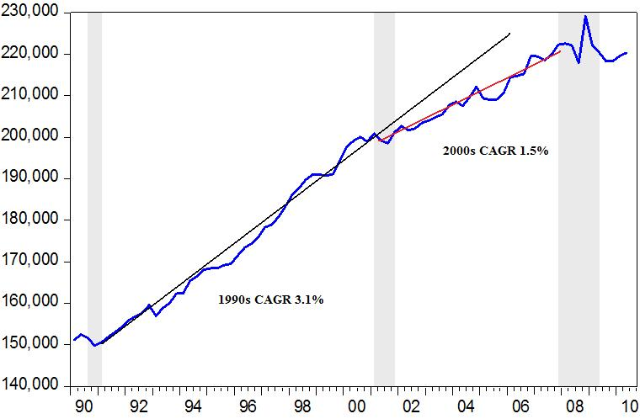
Missouri Personal Income

Slide 19
Growth in Missouri Personal Income (Year over Year)

Slide 20
Missouri Employment 2000-2010

Slide 21
Missouri Employment
Peak of 2,913,975 Dec. 2006
Trough of 2,704,225 Aug.2010
2010 Average 2,711,858

Slide 22
Missouri Employment (Percent Change Year over Year)

Slide 23
US and Missouri Job Losses (December 2007 to June 2009)

Slide 24
Monthly Change in Employment

Slide 25
Change in US and Missouri Employment (Percent relative to Jan 2006 Employment level)

Slide 26
US and Missouri Employment
0.8%
0.2%

Slide 27
US and Missouri Private Employment
Mo 0.52%
Mo 0.3%
US 1.03%
US 1.2%

Slide 28
US and Missouri Employment (June 2009 to Present)

Slide 29
Missouri Employment in Recovery Index (Employment in Month 1 of Recovery = 100)

Slide 30
Missouri Private Employment (thds)

Slide 31
Change in Construction Employment (thds)

Slide 32
Change in Government Employment (thds)

Slide 33
Change in Health and Education Employment (thds)

Slide 34
Change in Professional Business Services Employment (thds)

Slide 35
Change in Manufacturing Employment (thds)

Slide 36
Where is Missouri Growing? (December 2009 to today)
Kansas City (-6,082)
St. Louis (10,273)
MSA Minor (8,541)
Rural (-7,874)

Slide 37
Springfield MSA Employment

Slide 38
Employment Throughout Missouri
Area | Employment | Percent of Missouri Employment
St. Louis | 980,405 | 36.1%
Kansas City | 553,824 | 20.4%
Minor MSAs | 497,144 | 18.4%
Rural | 677,842 | 25.1%
Total | 2,709,215

Slide 39
Missouri Employment Breakdown (thds)
Industry | Dec 2006 | Nov 2010 | Change | Relative Size
Nonfarm (CES) | 2,788.8 | 2,653.50 | -135.3 | ---
Private | 2,352.7 | 2,195.00 | -157.7 | 82.7%
Construction | 147.6 | 103.6 | -44.0 | 3.9%
Financial | 165.6 | 156.7 | -8.9 | 5.9%
Government | 436.1 | 458.8 | 22.7 | 17.3%
Health | 381.2 | 408.4 | 27.2 | 15.4%
Information | 63.1 | 61.8 | -1.3 | 2.3%
Leisure | 280.8 | 277.6 | -3.2 | 10.5%
Manufacturing | 304.8 | 246.5 | -58.3 | 9.3%
Mining | 5.2 | 4.1 | -1.1 | 0.2%
Prof Biz Services | 338.8 | 308.6 | -30.2 | 11.6%
Retail | 316.2 | 297.8 | -18.4 | 11.2%
Trans/Utilities | 106.5 | 94.7 | -11.8 | 3.6%
Wholesale | 124.2 | 115.4 | -8.8 | 4.3%
Other Services | 120.5 | 119.5 | -1.0 | 4.5%

Slide 40
Missouri Unemployment Rate

Slide 41
Major City Unemployment Rates

Slide 42
Change in Taxable Sales 2009 to 2010

Slide 43
Change in Taxable Sales 2007 to 2010

Slide 44
2011 Missouri Forecast
Industry | 10-Nov | 2011 | Change | Percent
Nonfarm (CES) | 2,653.50 | 2,668.50 | 15.0 | 0.57%
Private | 2,195.00 | 2,215.00 | 20.0 | 0.91%
Construction | 103.6 | 104 | 0.4 | 0.39%
Financial | 156.7 | 153.7 | -3.0 | -1.91%
Government | 458.8 | 453.5 | -5.3 | -1.16%
Health | 408.4 | 412.8 | 4.4 | 1.08%
Information | 61.8 | 61 | -0.8 | -1.29%
Leisure | 277.6 | 283.6 | 6.0 | 2.16%
Manufacturing | 246.5 | 248.5 | 2.0 | 0.81%
Mining | 4.1 | 4.6 | 0.5 | 12.20%
Prof Biz Services | 308.6 | 314 | 5.4 | 1.75%
Retail | 297.8 | 301.4 | 3.6 | 1.21%
Trans/Utilities | 94.7 | 97.3 | 2.6 | 2.75%
Wholesale | 115.4 | 116 | 0.6 | 0.52%
Other Services | 119.5 | 121 | 1.5 | 1.26%
Spfd Employment | 199.8 | 202.7 | 2.9 | 1.43%
Mo Unemployment Rate (SA) | 9.90% | 8.50%
Spfd Unemployment Rate (SA) | 8.70% | 7.90%
Real Personal Income | 219,620 | 222,694 | 3,074 | 1.40%

